Slide 1
laboratory safety rules for physiology

Slide 2
laboratory safety rules for physiology
The following is a list of rules that is designed to ensure your safety as well as the safety of your classmates and instructor.
Failure to follow these safety rules may result in the removal from class on the day of the incident.
Violation of the rules may result in a referral to the head department for disciplinary action.

Slide 3
laboratory safety rules for physiology
Chemicals used in this course are believed to be safe when used according to standard laboratory safety practices. However, their total or long term effects on the human body Chemicals used in this course are believed to be safe when used according to standard laboratory safety practices. However, their total or long term effects on the human body arChemicals used in this course are believed to be safe when used according to standard laboratory safety practices. However, their total or long term effects on the human body are not known.e not known.arChemicals used in this course are believed to be safe when used according to standard laboratory safety practices. However, their total or long term effects on the human body are not known.e not known.

Slide 4
laboratory safety rules for physiology
Note safety signs in the lab.
Eating, drinking, chewing gum, smoking are not permitted. Keep your fingers, pencils, and other objects out of your mouNote safety signs in the lab.
Eating, drinking, chewing gum, smoking are not permitted. Keep your fingers, pencils, and other objects out of your mouth. th.

Slide 5
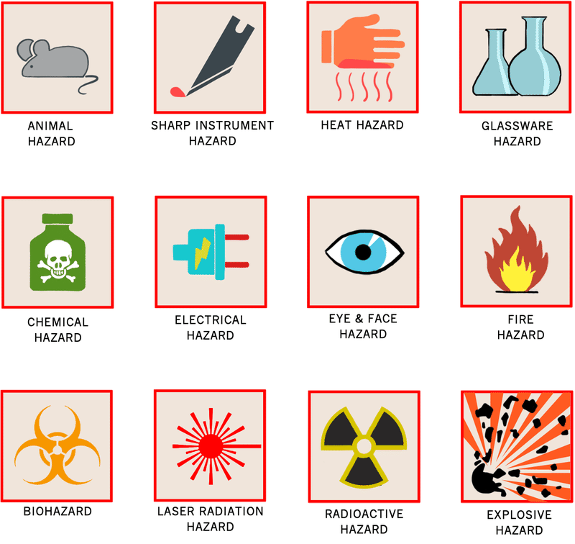

Slide 6
laboratory safety rules for physiology
Appropriate clothing, including shirt and closed-toe shoes must be worn at all times. Lab coats are required at all times. If gloves are required, dispose of the gloves before leaving the class.
Working in the laboratory without the instructor present is prohibited.

Slide 7
laboratory safety rules for physiology
Keep your personal items out of your work space and aisles at all times.
If animals or preserved specimens are being used in the laboratory, do not handle them without the permission and supervision of your instructor, and treat them with respect.

Slide 8
laboratory safety rules for physiology
Do not eat any laboratory specimens or products.
Use proper technique in handling containers of acids, bases, and other chemicals. Do not pipette by mouth.

Slide 9
laboratory safety rules for physiology
Follow instructions regarding the use and care of scissors and sharp pointed metal items.
Follow your instructor’s directions for proper care of laboratory equipment. When plugging equipment, make sure that your cord does not cross a walkway.

Slide 10
laboratory safety rules for physiology
After working with chemicals at your lab table, clean the table tops. Wash your hands with soap and water.
Follow the instructor’s directions regarding clean up and disposal of all lab materials. Make sure that biohazards, sharps, broken glass, chemicals, and garbage are all disposed of properly.

Slide 11
laboratory safety rules for physiology
If you break a thermometer or any other glassware, avoid contact with sharp objects and notify your instructor immediately.
If any chemicals are spilled on your skin or clothing, flush the affected area with water and notify your instructor immediately.

Slide 12
laboratory safety rules for physiology
If you splash any substance into your eyes, rinse your eyes for 15 minutes with water, and notify your instructor.
If your clothing catches on fire or you spill any corrosive chemicals on your skin or clothing, rinse the affected area with water, and inform your instructor.

Slide 13
laboratory safety rules for physiology
Photography, videos, and recordings can only be taken with instructor consent. They may not be given, sold, or published in print or online without the consent of the instructor, and can only be used for the purposes of the class.

Slide 14
Course: practical physiology Semester: 1 Year: 2018 Instructor: M.Sc Mariem Nbeel M.A.
I certify that I have read and understood the safety rules for this course, and that I agree to abide by them.
No. | Name | Signature
1.
2.
3.
4.
5.

